Slide 1
Let`s speak about music
The lesson in the 8th form

Slide 2
The world without music
All day all night music is in my head
Life without music is like bees without honey
Life would be dead without music
I love music for more than just its tune
Life without music is like bees without flowers
Life without music is a sad place
Another way to say this is that
Music brings joy to life
Jessica Coker

Slide 3
Match the English words to their Russian equivalents
1. tune a. духовой оркестр
2. folk song в. захватывающая мелодия
3. reggae music с. стихи к песне
4. guitar d. мелодия
5. brass band e. скрипка
6. percussion f. народная песня
7. jazz band h.джазовый оркестр
9. violin i. духовые инструменты
10. string instruments j. музыка регги
11. beat k. гитара
12. lover of music l. ударные инструменты
13. wind instruments m. струнные инструменты
14. catchy melody n. ритм
15. lyrics o. аранжировка

Slide 4
Passive Voice or Active Voice?
A sonata (to play) often by a big orchestra in a concert hall.
Rock (to perform) by young people with guitars in a group.
Punk rock usually (to play) by young people with brightly coloured hair.
Blues (to come) originally from black American musicians.
Pop music usually (to offer) simple tunes which is popular for a short time.
Folk music (to come) from specific region and is usually popular for a long time.
Reggae (to have) a strong regular rhythm. It`s originally from Jamaica.
House dance music (to listen) in discos.
Jazz (to play) freely, not following written music.
My brother (to play) the piano every evening.

Slide 5
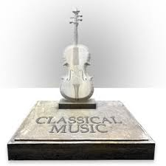
The defense of home presentation

Slide 6
Are you a lover of music?
1 | 2 | 3
4 | 5 | 6
7 | 8 | 9

Slide 7
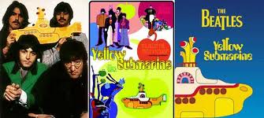
Yellow submarine
Revise some words:
1. Submarine is a ship, especially a military one, that can stay under water
2. Beneath is to be in or to a lower position than smth or directly under smth
3. Aboard is to go on or onto a ship, plane or train
4. Band is a group of musicians
5. To sail is to travel on or across an area of water in a boat or a ship

Slide 8
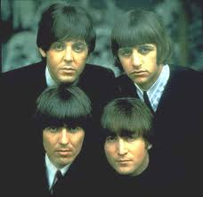
Let`s complete the song and sing “Yellow submarine”
In the town where I was _____(1)
____(2) a man who ____(3) to sea
And he told us of his life
In the land of submarines.
So we ________(4) on to the sun
Till we ________(5) the sea of green.
And we lived beneath the ___(6)
In our yellow submarine.
We all live in a yellow submarine,
Yellow submarine, yellow submarine.
We all live in a yellow submarine,
Yellow submarine, yellow submarine.
And our friends are all aboard,
Many more of them live _________(7).
And the band ___________(8) to play…
We all live in a yellow submarine,
Yellow submarine, yellow submarine.
We all live in a yellow submarine,
Yellow submarine, yellow submarine.
And we live a life of _____________ (9),
Everyone of us has all we need,
Sky of ____(10) and sea of ______11)
In our yellow submarine.

Slide 9
Let`s sing “Yellow submarine”
In the town where I was born(1)
Lived(2) a man who sailed (3) to sea
And he told us of his life
In the land of submarines.
So we sailed(4) on to the sun
Till we found(5) the sea of green.
And we lived beneath the waves(6)
In our yellow submarine.
We all live in a yellow submarine,
Yellow submarine, yellow submarine.
We all live in a yellow submarine,
Yellow submarine, yellow submarine.
And our friends are all aboard,
Many more of them live next door(7).
And the band begin (8) to play…
We all live in a yellow submarine,
Yellow submarine, yellow submarine.
We all live in a yellow submarine,
Yellow submarine, yellow submarine.
And we live a life of ease (9),
Everyone of us has all we need,
Sky of blue(10) and sea of green (11)
In our yellow submarine.

Slide 10
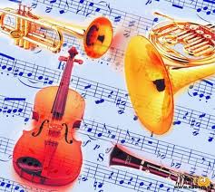
Home work
4-6 - to find and bring interesting information about Ukrainian singers or Ukrainian groups;
7-9 –to find the information, make a plan of the text and write a short summery;
10-12 – to retell the information after the plan

